Slide 1
DATA SCIENTIST INTERVIEW TASK
Drivers of energy usage in England and Wales
Wiktor Owczarz
July 2024

Slide 2
Task: identify drivers of energy consumption in England and Wales.
Outline:
Data Load
Exploratory data analysis
Modeling
Summary and future work

Slide 3

Dataset | Source | Data Type | Notes
Energy Consumption Data | Energy Systems Catapult | Avg. gas and electricity consumption per LSOA, est. population data. | Data for 2020/2021 based on 2011 census boundaries.
Energy Efficiency of Housing | Nomis | No. of Energy Performance Certificates (EPCs) by efficiency band (A-G) per LSOA. | Based on 2021 boundaries, valid for 10 years, not all dwellings covered.
Household Size from Census Data | 2021 Census | Household size, no. of rooms, no. of people per LSOA. | Based on 2021 boundaries.
Data on Dwellings by Council Tax Band | Valuation Office Agency | No. of properties in each tax band (A-I) per LSOA. | All counts rounded to nearest 10, counts 1-4 presented as 1, includes zeros. Based on 2021 boundaries.
Domestic Properties Energy Cost and Usage | Ministry of Housing, Communities and Local Government | Avg. lighting and heating cost per LSOA. | Filtered for 2021, yearly metrics from quarterly data, based on 339 LA codes, mapped to LSOA assuming local equality.
Rural Urban Classification (2011) of LSOAs | ONS | Rural-urban classification per LSOA. | Based on 2011 data.
Postcode to OA to LSOA to MSOA to LAD Lookup | ONS | Mapping from postcode to different geographic units (OA, LSOA, MSOA, LAD).
Notes:
Energy Efficiency, Household Size, and Tax Bands: Based on 2021 LSOA boundaries, covering 35,672 locations.
Other Datasets: Cover fewer locations (likely based on 2011, resulting in a combined dataset of 30,637 observations. Urban-Rural Classification: Based on 2011 data.
Better data sources are available. I would prefer separate energy consumption and population data from ONS Population Estimates and Electricity and Gas Estimates. Due to time constraints, this was not pursued. These sources include variables like median age and gender and are time series.

Slide 4
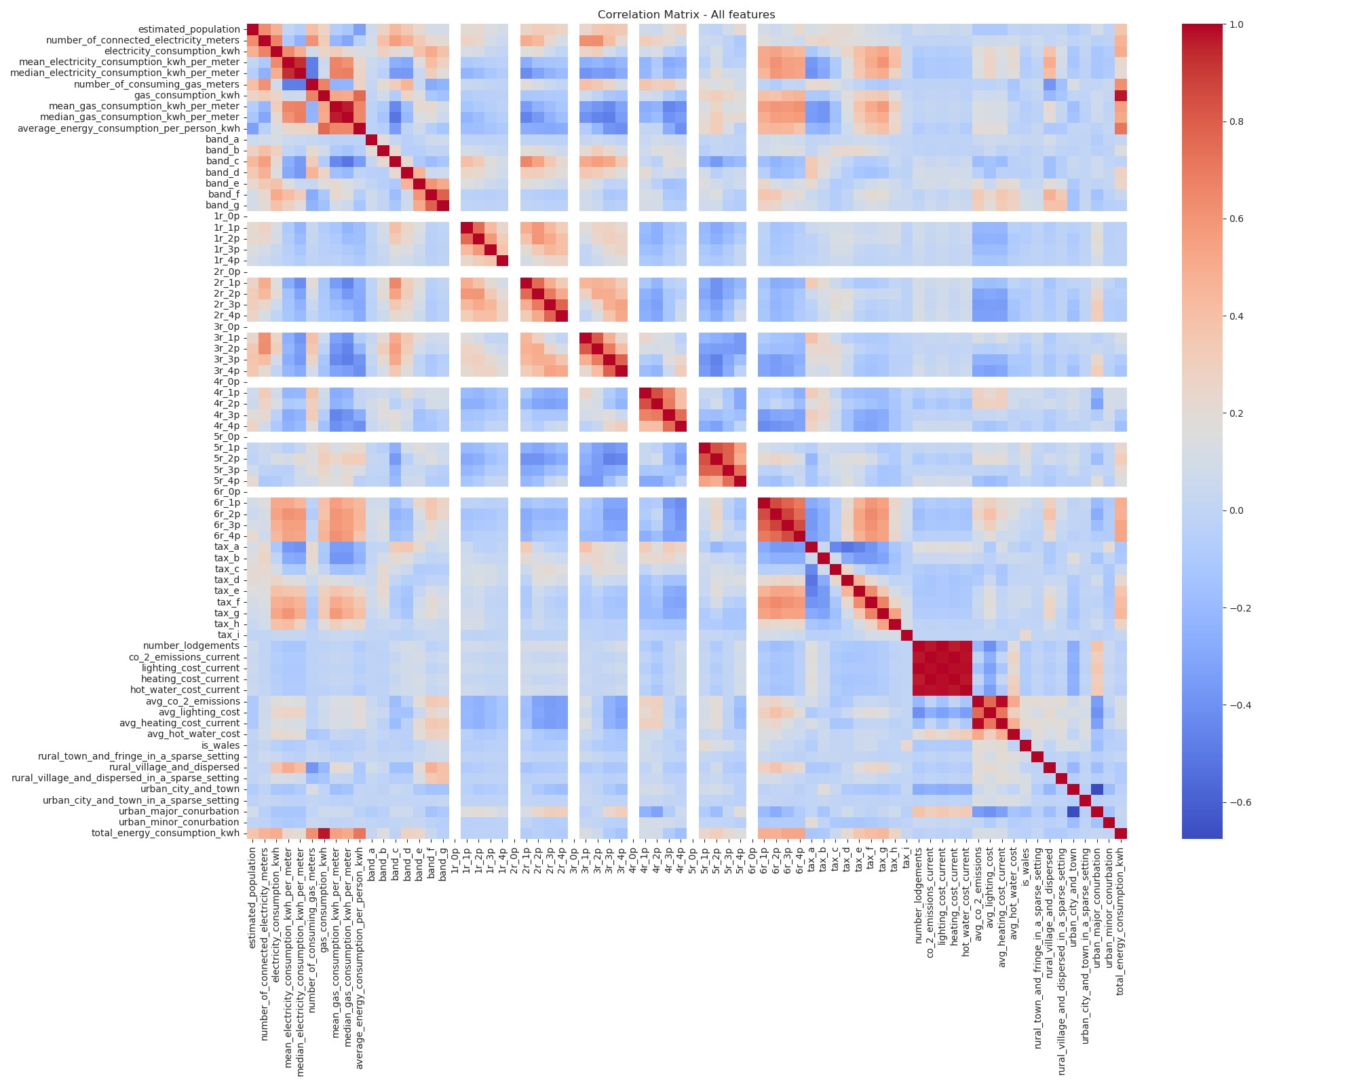
Energy consumption is highly correlated with
Number of electricity and gas meters.
Lower efficiency dwellings (Band D and E).
Bigger housholds (5 and 6+ rooms).
More expensive properties (Tax bands E-G).
Number of lodgments and current costs
Number of lodgments is a proxy for population density. Higher population should correspond to higher absolute overall energy usage and costs.
Rooms and occupancy
Strong correlations among houshold size features suggest those could be removed or combined.
Also I drop 0 occupancy variable as all values are 0 (white rows).

Slide 5
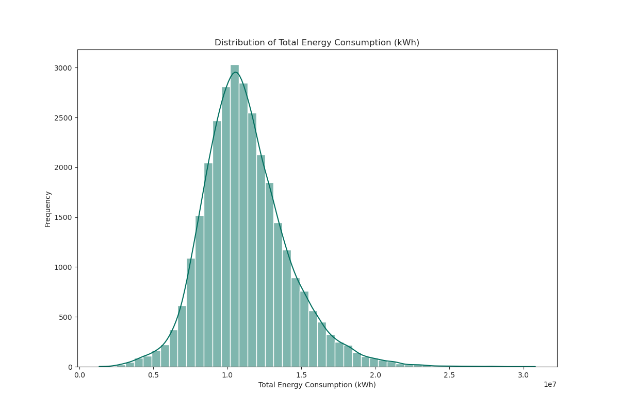
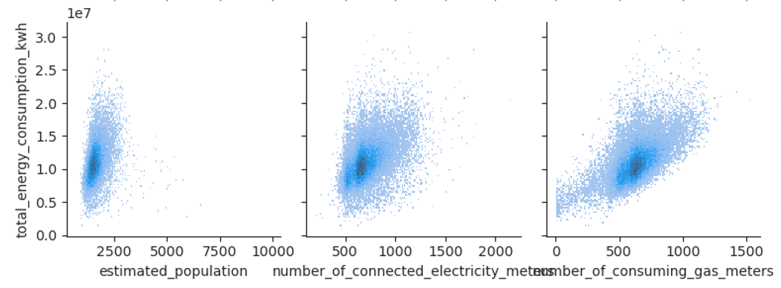
Total energy consumption appears to be normally distributed with a slight positive skew.
Log transformation helps to normalize the variable and stabilize variance, especially as there are some outliers.
Log transformation makes relationships between variables linear.

Slide 6
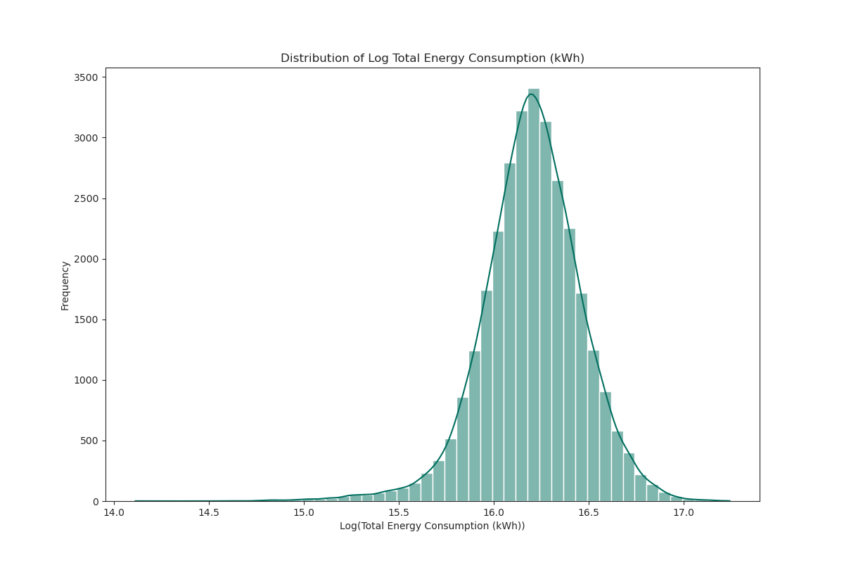
Log transformation

Slide 7
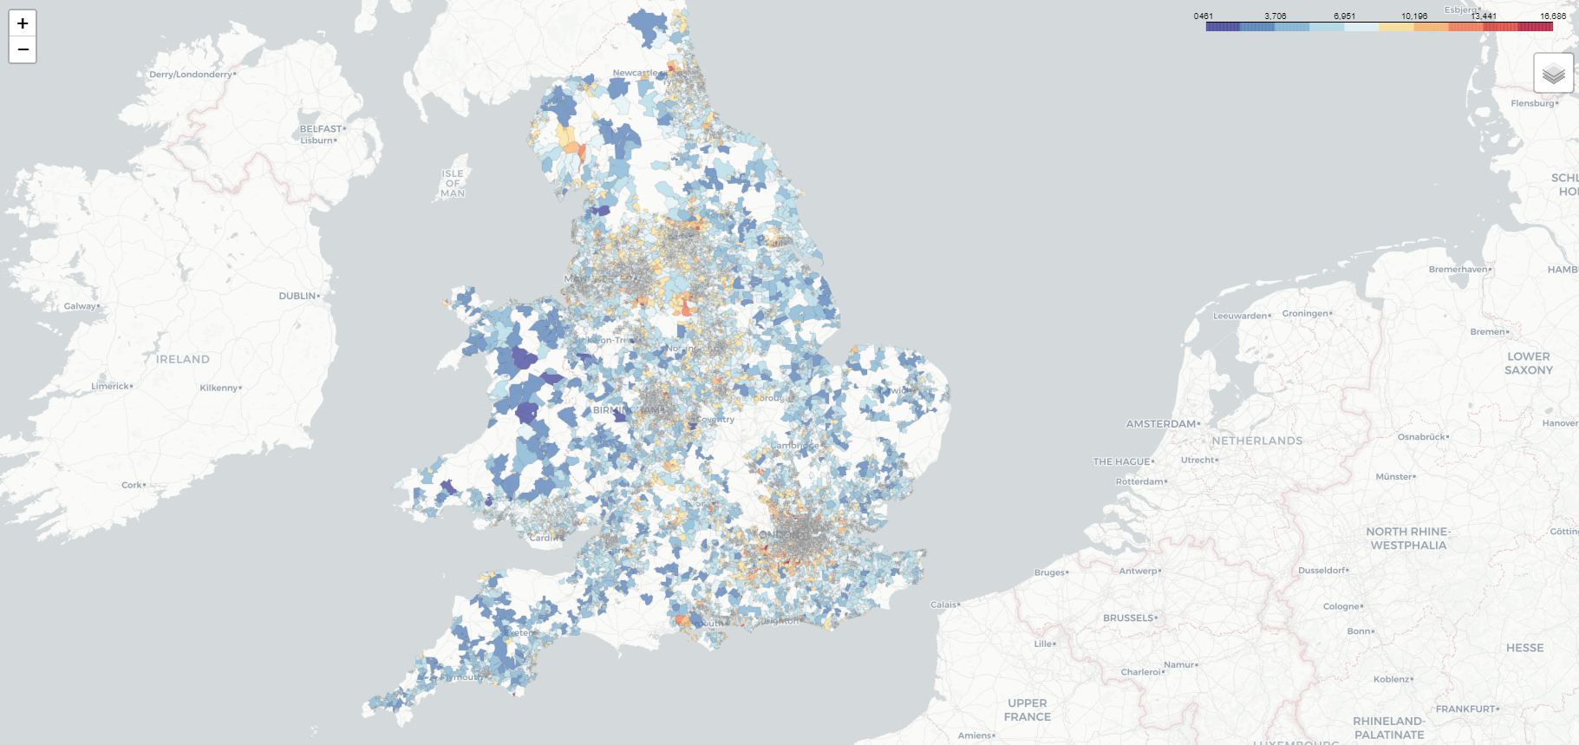

Slide 8



Modeling Process
Model | Reason for selection
OLS Regression | Provides a simple, interpretable model of linear relationships between predictors and energy consumption.
Ridge Regression | Helps address multicollinearity and overfitting by regularizing the coefficients, improving model robustness.
Random Forest | Captures complex, non-linear relationships and interactions between variables, offering high predictive power
Feature Selection: Identify and retain only the most relevant features for the model.
Hyperparameter Tuning: Find the best alpha for Ridge using grid search.
Model Fitting: Fit OLS Regression, Ridge Regression, and Random Forest models on the data
Performance Evaluation:
Perform 10-fold cross-validation to evaluate the models' RMSE.
Compare the feature importance scores from Random Forest with the coefficients from OLS and Ridge Regression to identify key drivers of energy consumption.

Slide 9
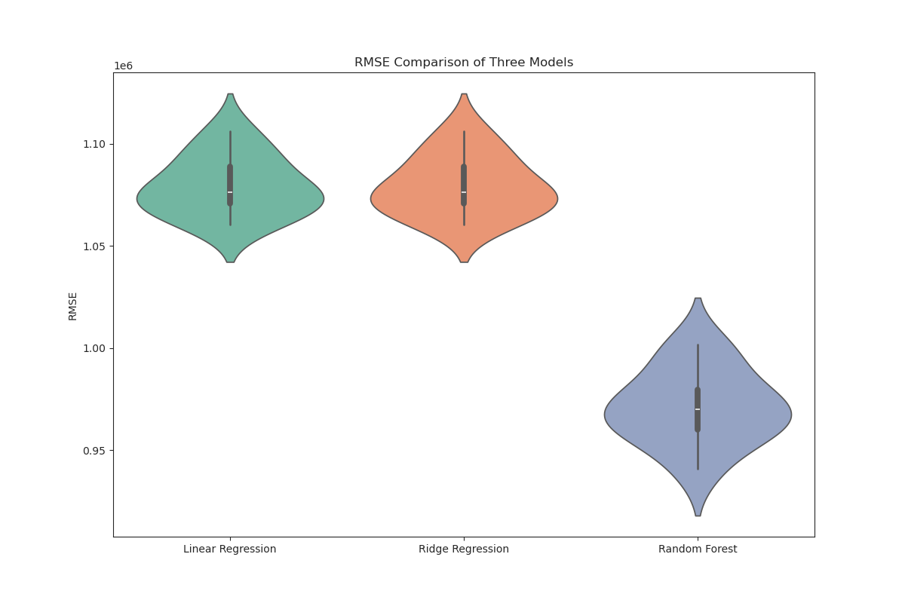
Baseline model
Notes:
The Random Forest model has the lowest RMSE, indicating it performs the best among the three models.

Slide 10
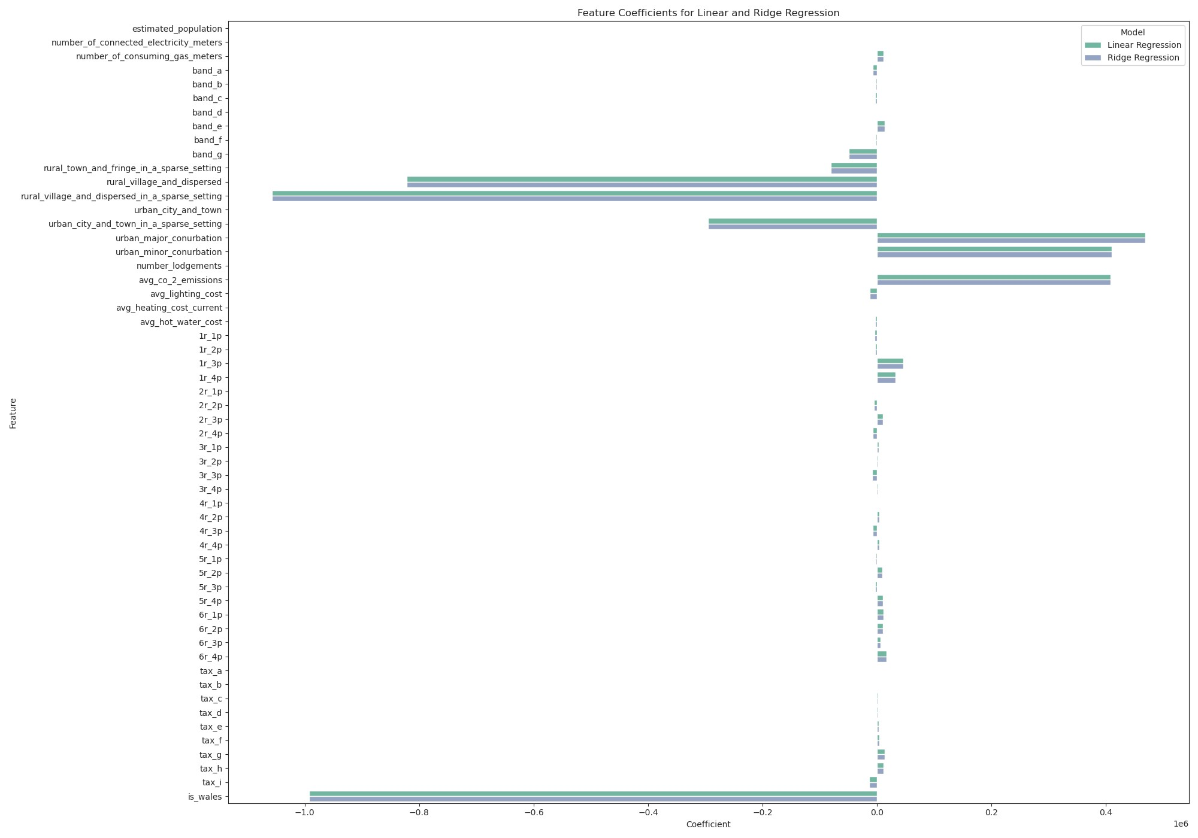
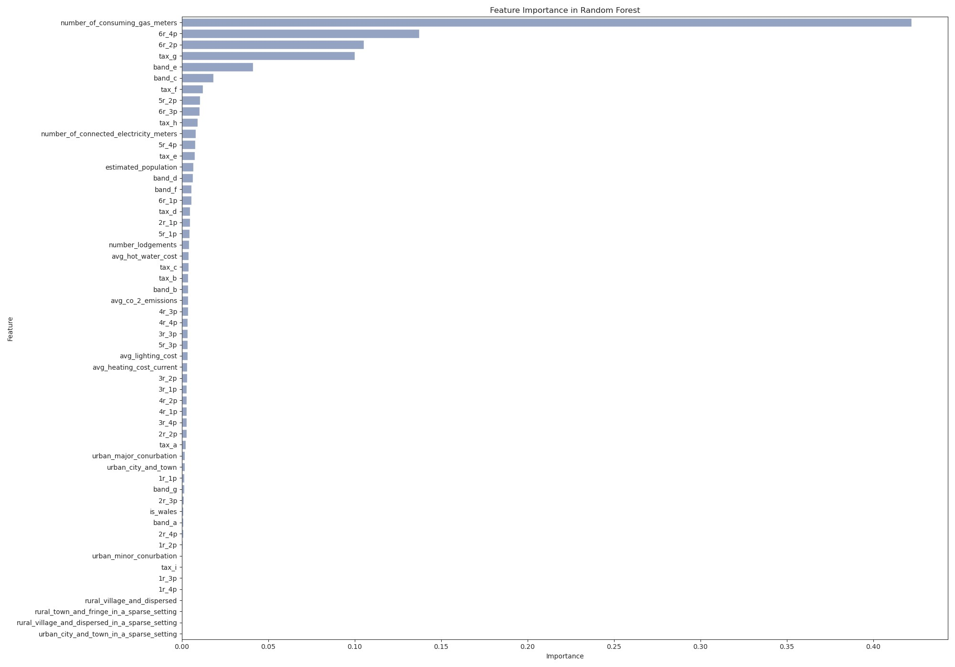
Baseline model

Slide 11
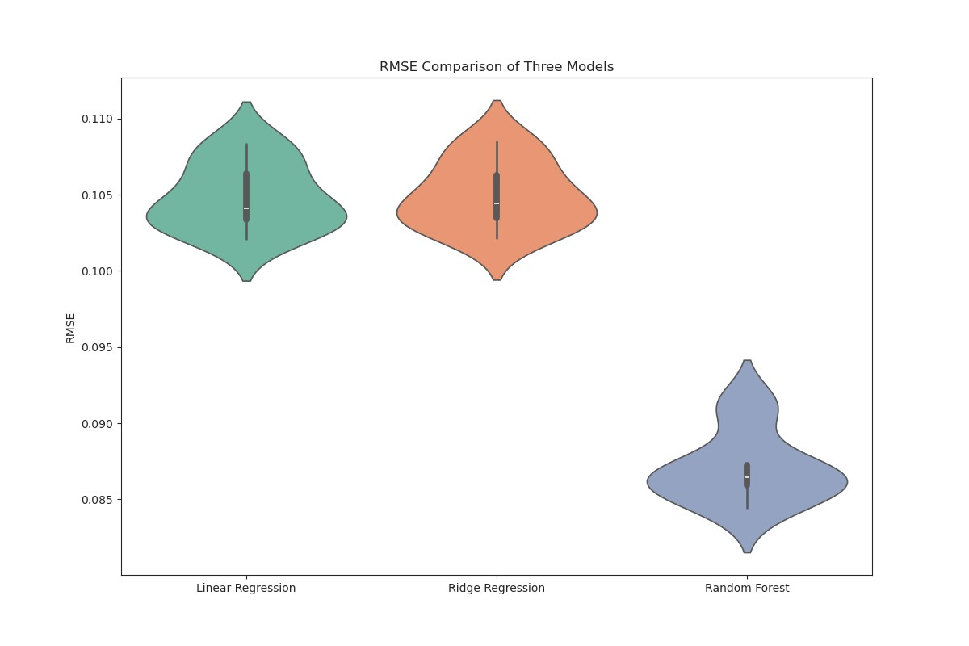
Log transformed model
Notes:
The Random Forest model has the lowest RMSE, indicating it performs the best among the three models.
The RMSE distribution for Random Forest is also more compact, suggesting it has more consistent performance.

Slide 12
Log transformed model
Baseline
Log transformed
Notes:
The Random Forest model has the lowest RMSE, indicating it performs the best among the three models.
The RMSE distribution for Random Forest is also more compact, suggesting it has more consistent performance.

Slide 13
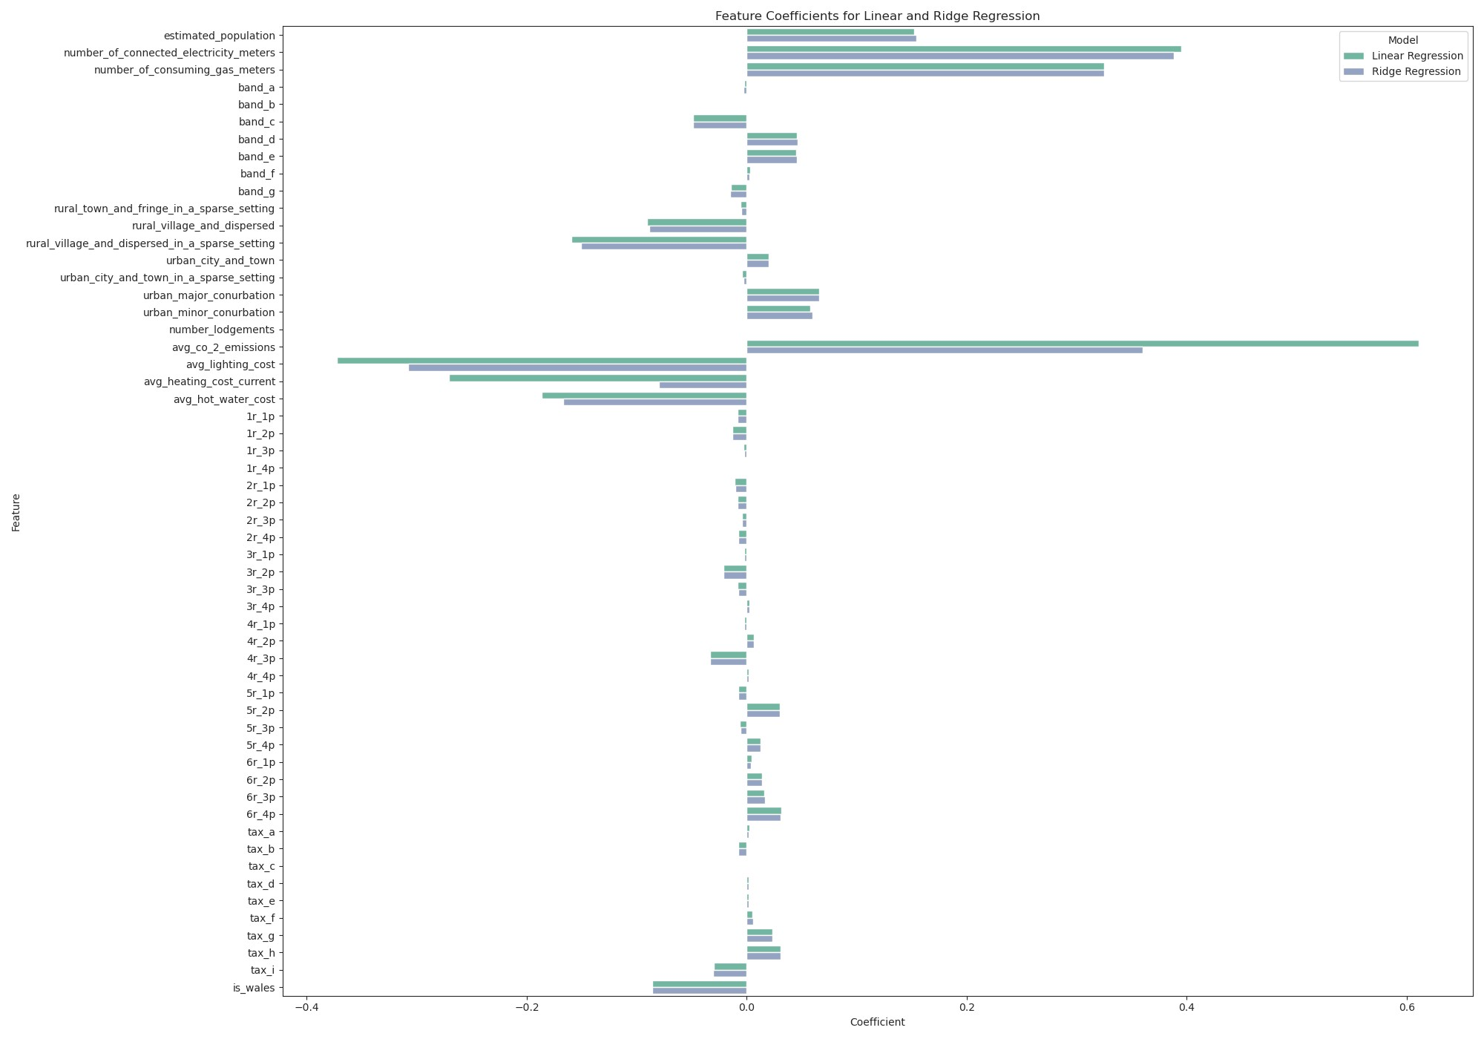
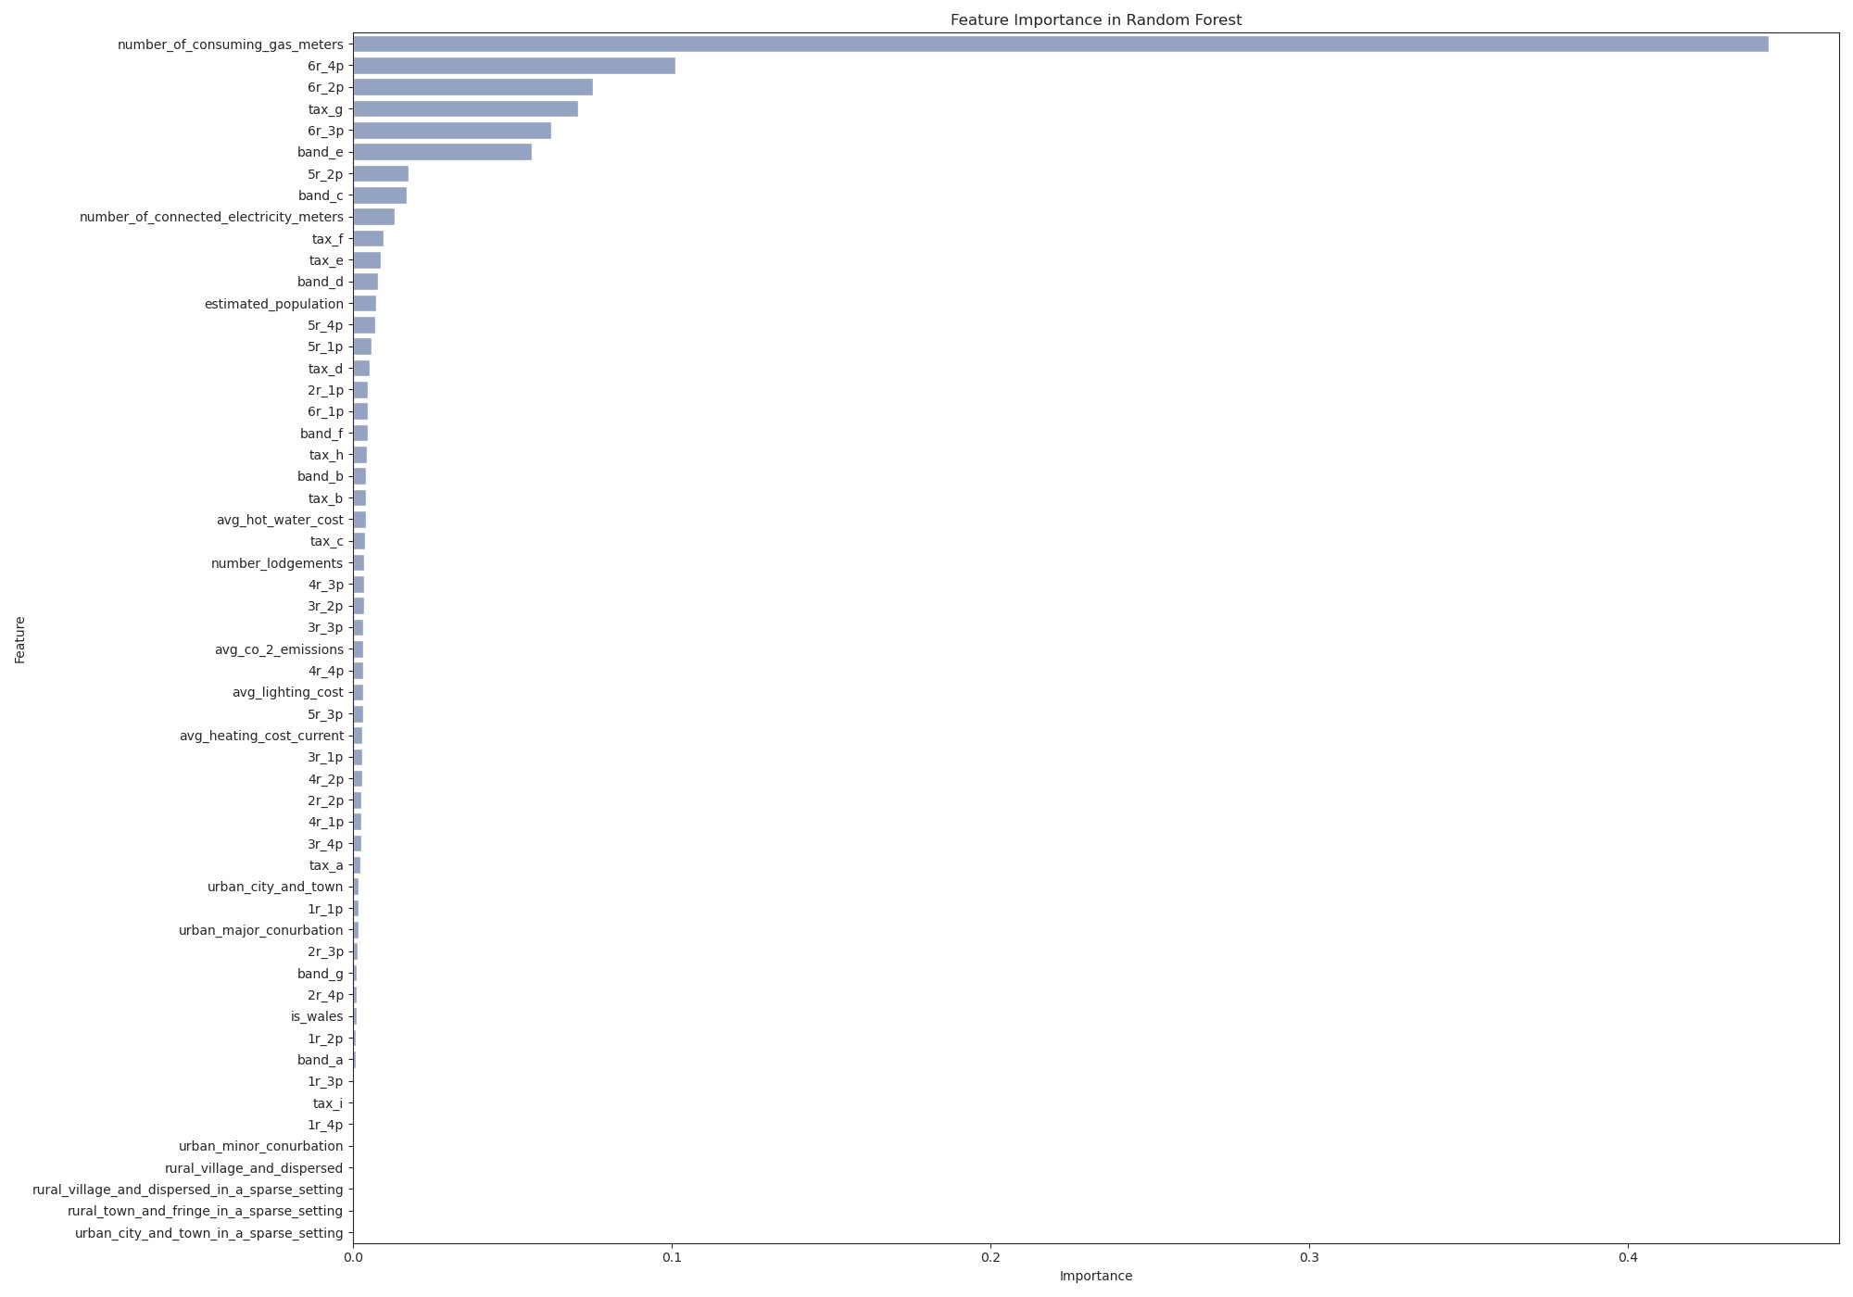
Log transformed model
Best alpha: 4.71

Slide 14
Summary and future work
Key Findings
OLS Regression and Ridge Regression:
Provided interpretable linear relationships between predictors and energy consumption. Indicated that geographical location (e.g., being in Wales) and rural settings are significant predictors of energy consumption.
Random Forest:
Captured non-linear relationships and interactions between variables. Identified additional important features, highlighting complex interactions not captured by linear models.
Future Directions for Analysis
Utilize Panel Data:
Incorporate time-varying data to analyze trends and patterns over time.
Incorporate Domain Knowledge:
Investigate potential policy changes or events that could impact energy consumption.
For example, compare energy consumption in Wales before and after a policy change using methods like difference-in-differences.
Or; more advanced causal inference techniques such as Double Machine Learning (DML) to account for non-linear relationships.
Stratified K-Fold Cross-Validation:
Explore using Stratified K-Fold Cross-Validation to account for geographical heterogeneity and ensure more balanced folds.

